Slide 1
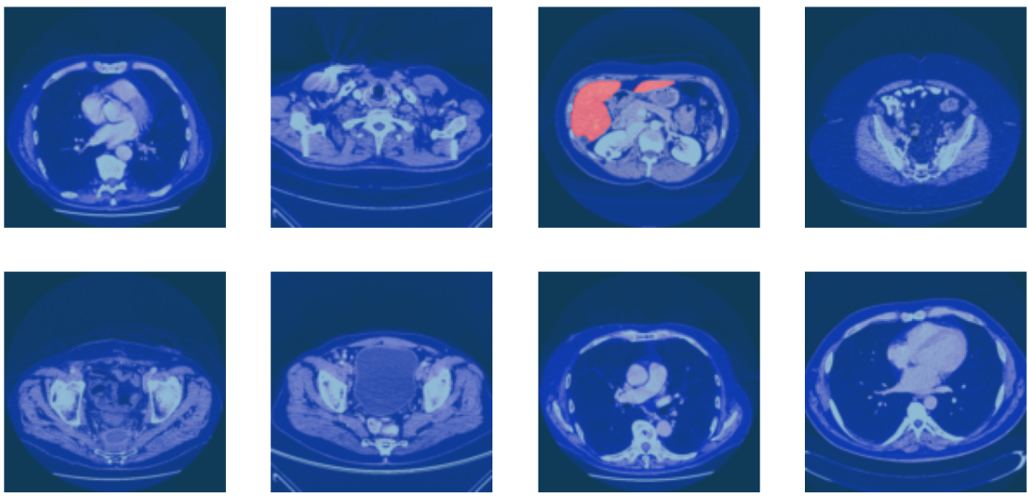


Deep Learning For Liver Segmentation
Guide: Prof.Siddique Ibrahim Peer Mohamed

Slide 2
Team Members
Amarnath Chigurupati
Regno:21BCE8893
mail:amarnath.21bce8893@vitapstudent.ac.in
Madhuri Sirasanagandla
Regno:21BCE8217
mail:madhuri.21bce8217@vitapstudent.ac.in
Ankit Kommalapati
Regno:21BCE8228
mail: ankit.21bce8228@vitapstudent.ac.in

Slide 3

01
Introduction
Outline For
02
Architecture
03
Methodology
Deep Learning for Liver Segmentation
04
Comparison chart of our model and existing model
05
Results & Future work

Slide 4
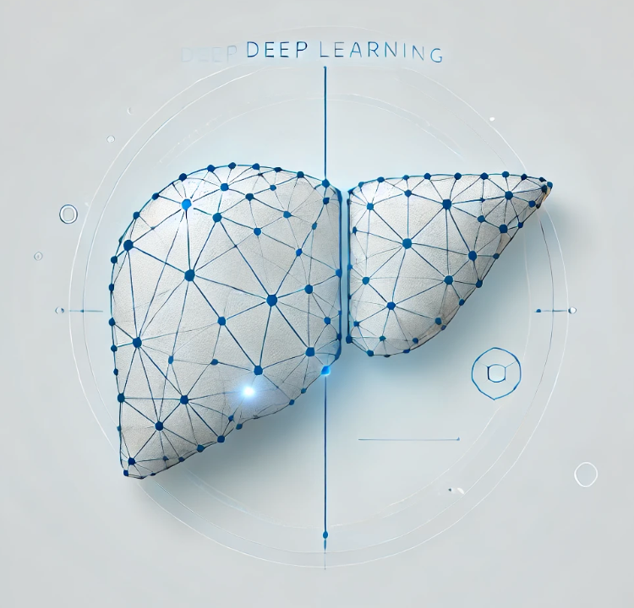
Introduction
Liver segmentation plays a crucial role in diagnosing and treating liver-related diseases. Manual segmentation is time-consuming, error-prone, and often inconsistent across radiologists.
To address this, we propose a deep learning-based model, specifically U-Net, trained on CT scans to automate the segmentation process of liver and tumor regions.
This project aims to reduce clinical workload, enhance diagnostic precision, and provide a scalable solution using AI in medical imaging.

Slide 5
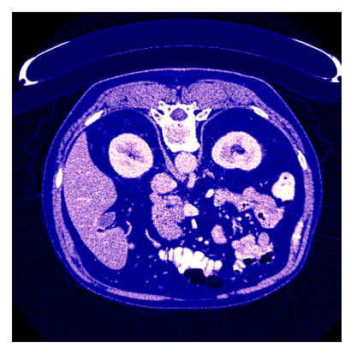
Manual segmentation methods are highly subjective and inefficient.
Existing image processing techniques struggle with:
1. Poor contrast between liver and tumor
2. Shape variability of organs
3. Presence of noise in CT images
Accurate detection of tumor boundaries remains a major challenge.
Accurate detection of tumor boundaries remains a major challenge.

Slide 6
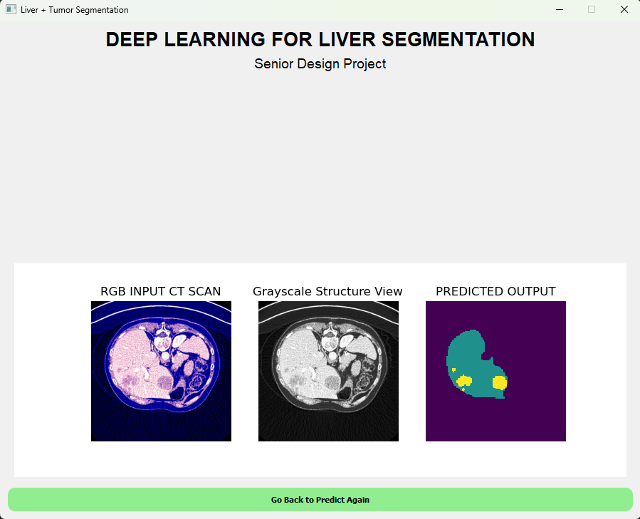
We wanted to develop a model
Develop a deep learning model for fast and better segmentation.
Train and evaluate the model on the LiTS dataset (CT scans).
Accurately segment liver and tumor areas with a Dice Score > 0.9.
Minimize dependency on manual effort in medical diagnosis.
Provide a scalable framework for future multi-organ segmentation systems.

Slide 7
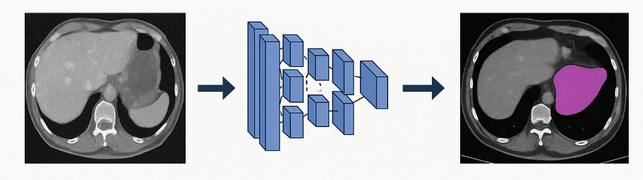
Why Deep Learning for Liver Segmentation?
Traditional methods (thresholding, region growing) are sensitive to noise.
Deep learning provides automatic feature extraction and high accuracy.
Helps radiologists reduce workload and improves diagnostic consistency.
Advances in GPU computing enable real-time inference in hospitals.

Slide 8
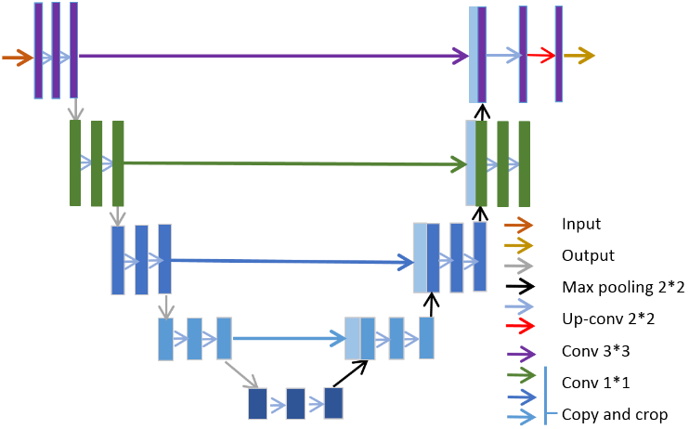
Architecture – U-Net + ResNet
Encoder: ResNet-34 for rich feature extraction.
Decoder: U-Net-based upsampling with skip connections.
Enhancements: Batch normalization, data augmentation.
Combines deep residual learning with precise localization.

Slide 9
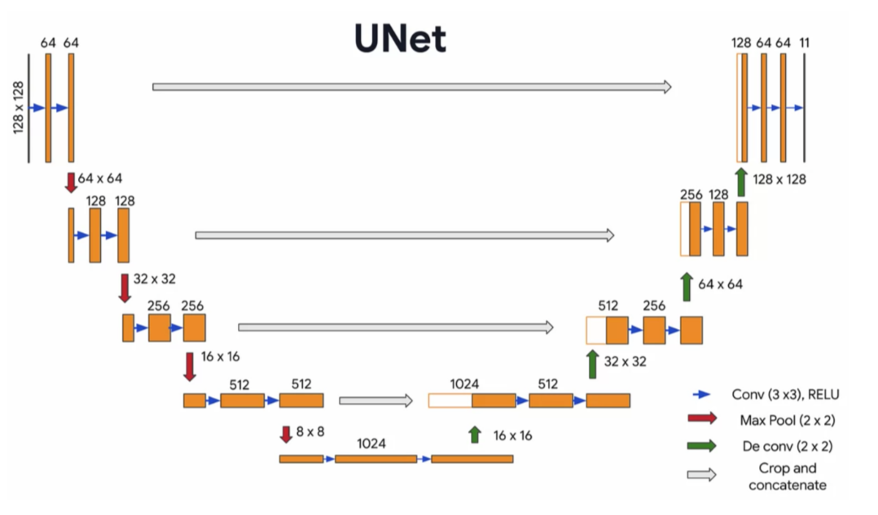

Input CT image → ResNet encoder → Decoder with skip connections → Segmentation mask.

Slide 10
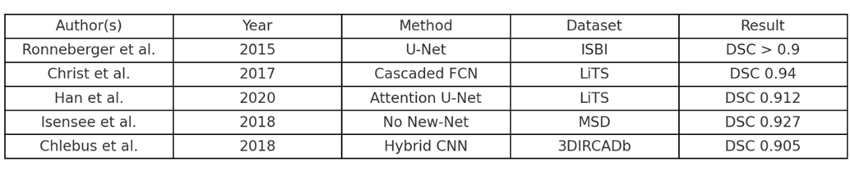
Literature Survey

Slide 11
Methodology
Dataset: LiTS (Liver Tumor Segmentation) dataset.
Format: NIfTI CT images with ground truth masks.
Steps: Normalization, resizing, slicing into 2D images.
Augmentations: Rotation, zoom, contrast shift to avoid overfitting.

Slide 12
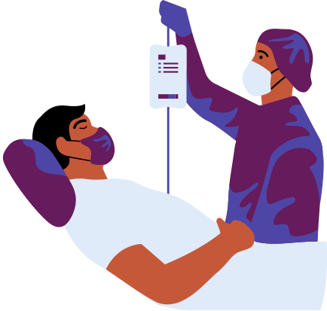
Training
•Model: U-Net with ResNet34 encoder
•Loss Function: CrossEntropyLossFlat with axis=1
•Batch Size: 16
•Epochs: 8 epochs using fine tuning
•Weight Decay: 0.1
•SaveModelCallback saves best model

Slide 13
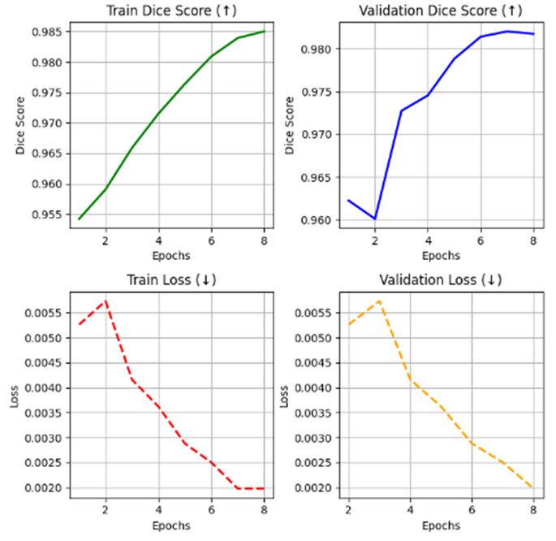
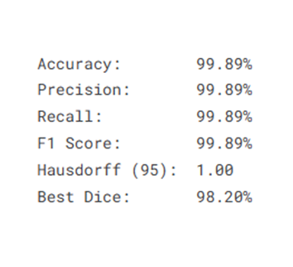
Evaluation Results
Dice Score: 0.9850 (training), 0.9820 (validation)
Accuracy: 99.8% on validation set
Outperforms traditional U-Net and cascaded models
Visually better segmentation at boundaries and tumor edges

Slide 14
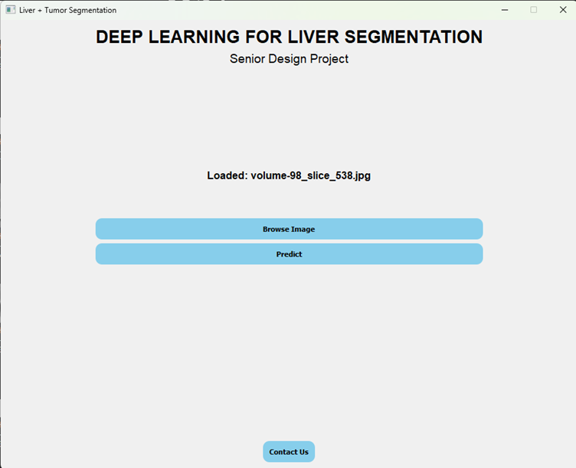

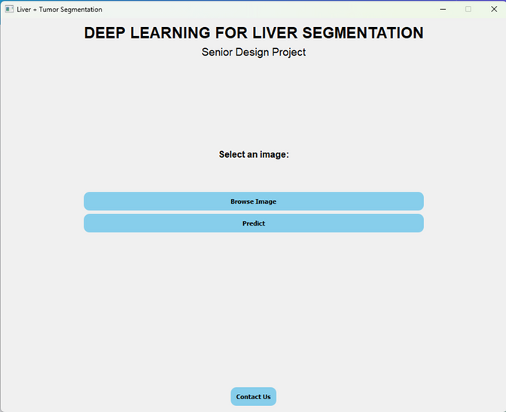
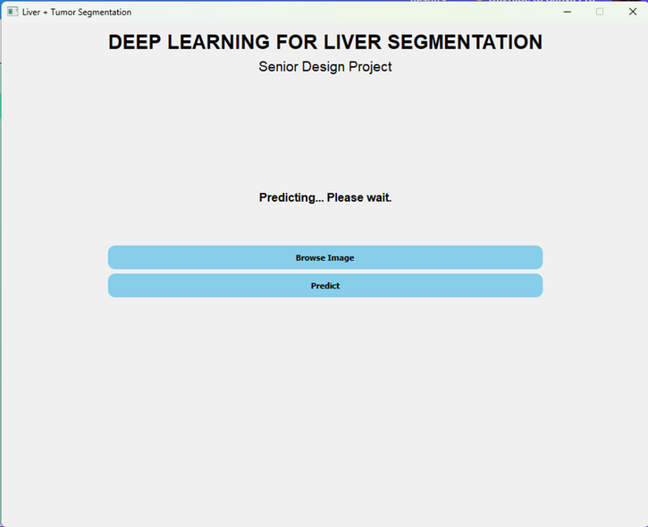

Results

Slide 15
Future Work
Use 3D segmentation models for better spatial understanding.
Include MRI images to test cross-modality performance.
Deploy on cloud with real-time inference using ONNX/TensorRT.
Collaborate with hospitals for clinical trials.

Slide 16
Thank
you!

